Slide 1



Slide 2

APR
Feel Like Your
APR Program
has Stalled Out?
Gain Insight into Your
Challenges…Are You Ready?
Overview of Successful
APR Ready to Roll Program
The Secret Formula
Turnkey to Get Moving… TODAY!!

Slide 3
APR
APReadiness…
Do you have a designated APR chair?
Current APR willing to support/amplify/promote the importance of APR and messaging to chapter?
Board willing to provide financial support ($150-200 reimbursement as incentive to each candidate)?
Enough APRs to assist with panel presentations, mentorship, leading study sessions?
Ready to support on social media channels (time commitment)?
Enough energy, drive to succeed, cheerleader hat?
Location/space/online capabilities?
Someone to organize, share panel packets, connect with candidates?
Resources (sample questionnaires, portfolios, etc.)?
Your own ideas?
If yes…

Slide 4

APR

Slide 5

Your
APR Ready to Roll
Game Plan

Slide 6
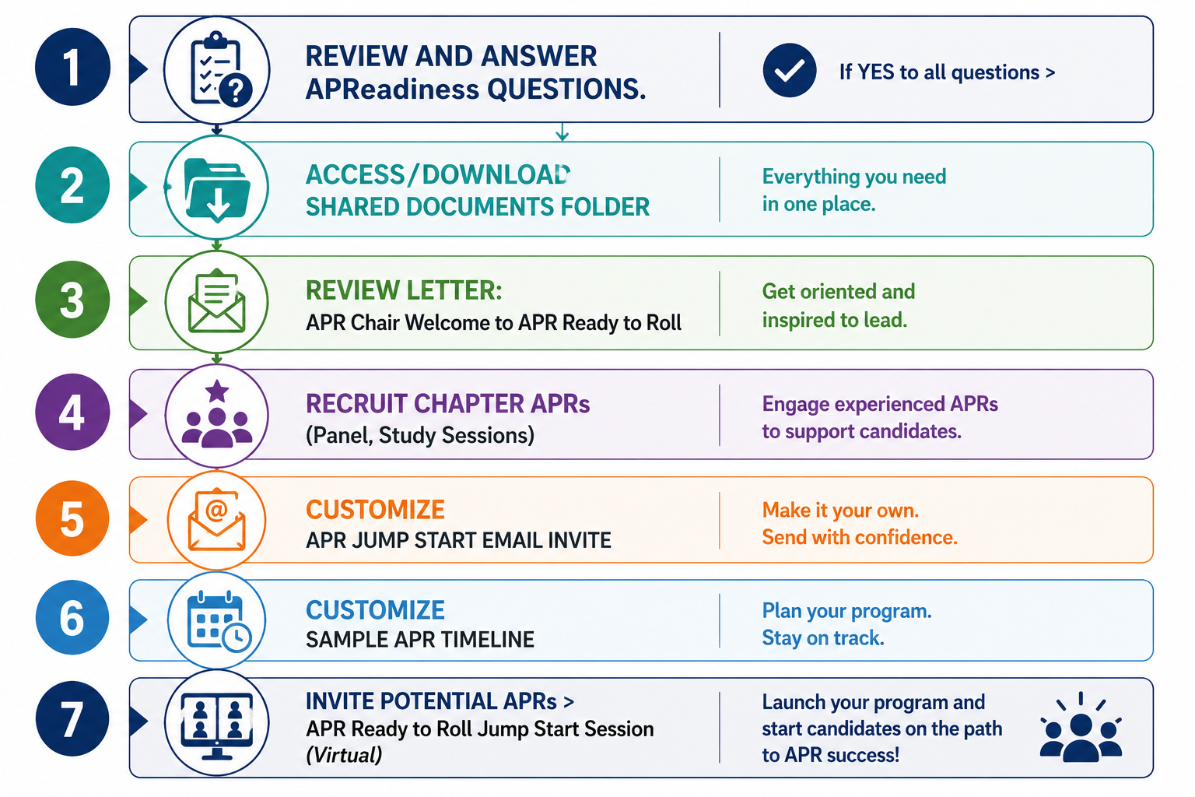
Recap & Questions

Slide 7
Shared Documents Folder:
Letter / Overview of APR Ready to Roll Program
Table of Contents
  Sample Communications:
    Promotions / Events and Recruitment
    Invitation to Attend an APR Ready to Roll Jump Start (virtual session)
    Communication - chapter APRs requesting assistance/support leading a session, panel, Lessons Learned, etc.
  Handouts at Jump Start / First Meeting
  Sample Calendar / Timeline (stick to your APR guns – strict)
  APR Questionnaire
  Study Session Power Points (PDFs from UAB, etc.)
  Panel Presentation materials (candidate and panel)
  Unique/creative approaches (incentives for completing/
  passing exam 60 days, lending library, etc.)
  Convey value of APR with employers
  YOUR APR Maintenance every 3 years!

Slide 8
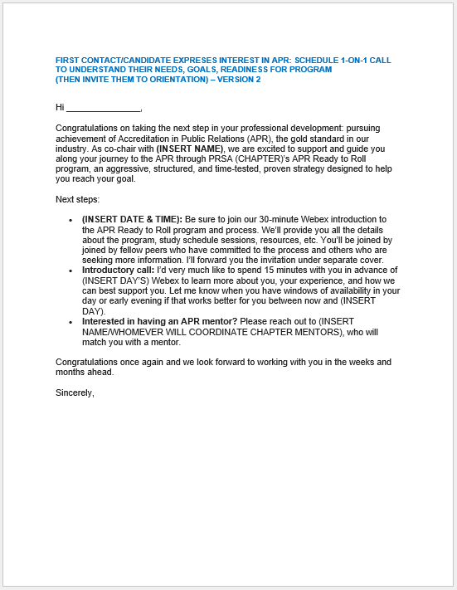
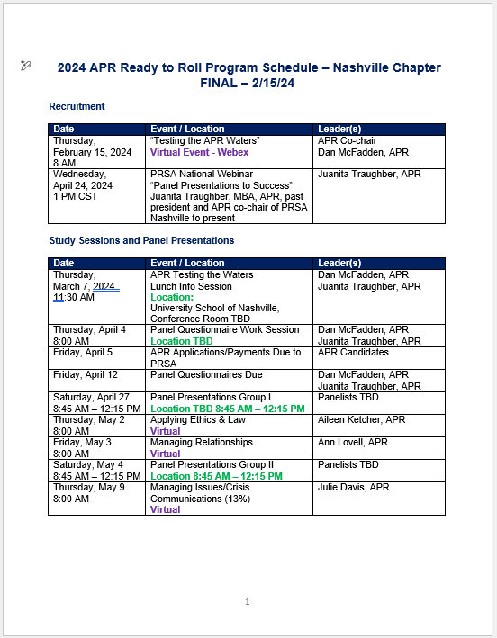
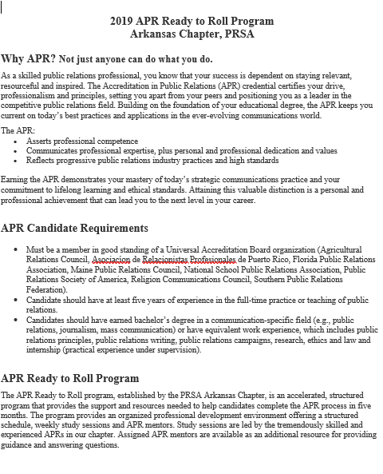
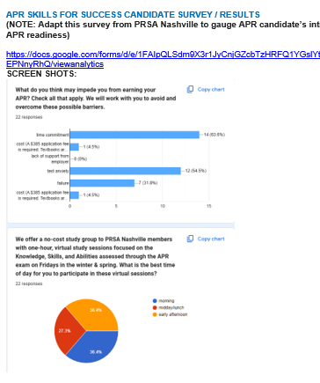
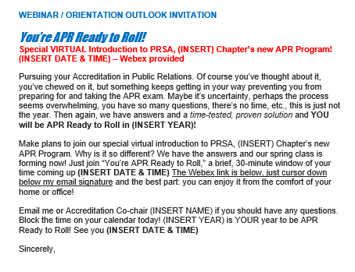
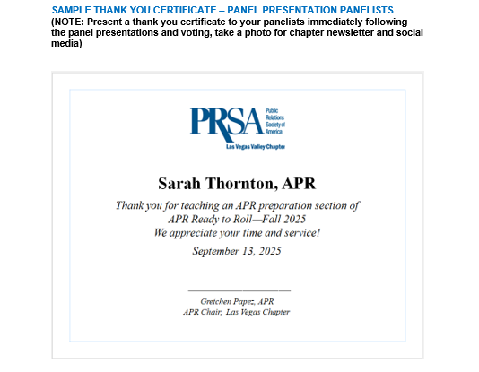
EVERYTHING
You Need Including
What You WON’T Find
Elsewhere

Slide 9
APR
NOTE TO APR CHAIRS:
This is the full APR Ready to Roll JUMP START deck for orientation/introductions from this point forward. Customize with dates, names, etc. as needed!

Slide 10
JUMP START:
Testing the Waters, Pursuing Your APR

Slide 11
APR
Understand the APR
Program Background
Commitment
Resources
Support & Expectations
Portfolio Review & Panel
Presentation
Demystifying the APR Exam

Slide 12
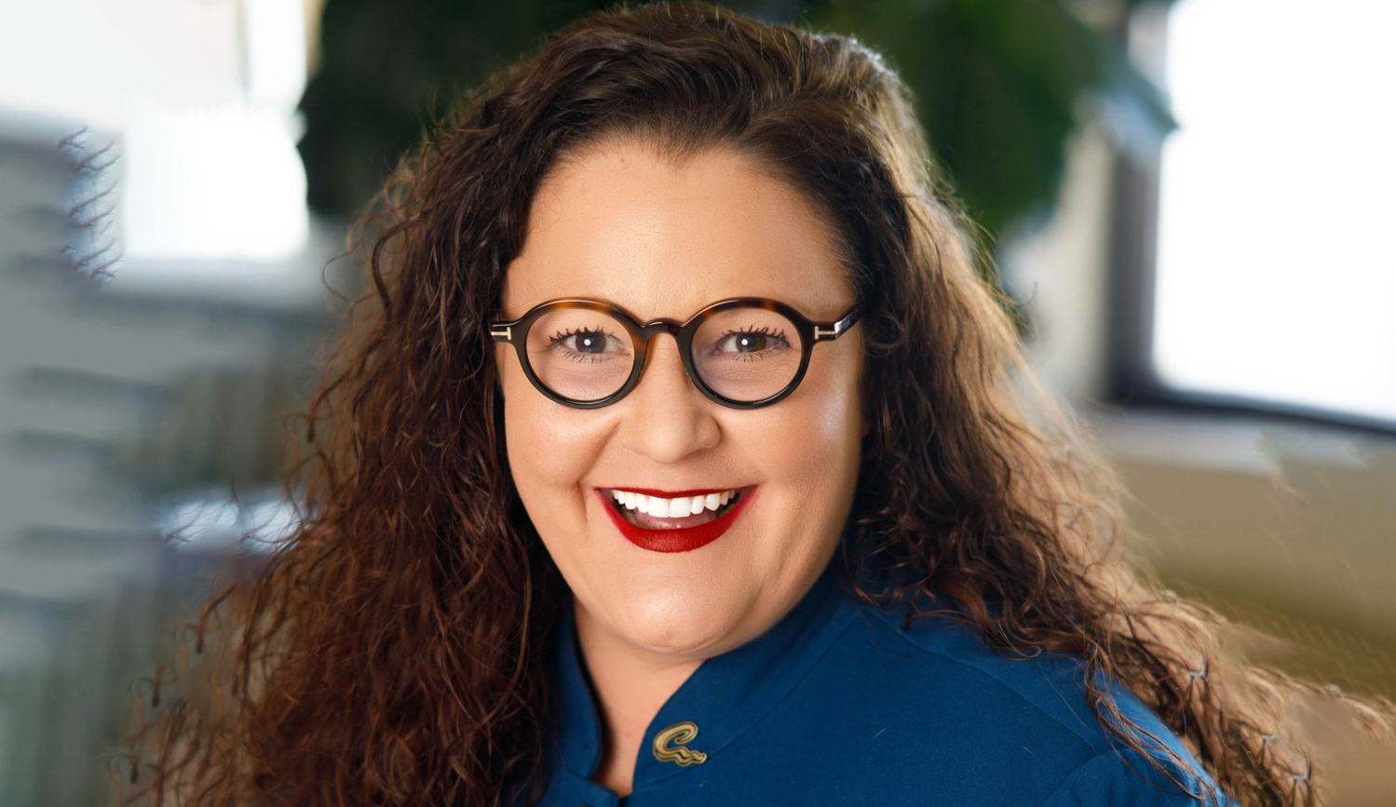
Heide Harrell, MA, APR
PRSA Board Chair:
“APR Ready to Roll was built on a simple but powerful
foundation. Understanding the real challenges candidates
face and addressing them head-on with research-driven support,
structure and encouragement. From its beginnings in Arkansas to its growth in chapters across the country, the program has consistently demonstrated that when you equip professionals with the right tools, mentorship and accountability, success follows.
More than 15 years later, its impact is evident not only in strong accreditation outcomes, but in the leaders it continues to develop, many of whom go on to serve and strengthen our profession. That sustained success is a testament to the passion of our APR chairs, the commitment of our candidates and the advocacy of those who have experienced firsthand how transformative the program can be.”
Notes:
Ultimate testimonial – PRSA Board Chair Heide Harrell, MA, APR – conducted the research that became the foundation of the PRSA/Arkansas chapter-originated
APR Ready to Roll program, supporting Dan McFadden, APR as Accreditation chair, along with Bruce Trimble, APR

Slide 13

APR
As a skilled PR professional, you
know that your success is dependent
on staying relevant, resourceful, and inspired.

Slide 14

Can I really do this?
We polled our PR studio audience…
Top 5 answers on the board:
Name a reason
why you’ve
been reluctant
to pursue APR?

Slide 15

Can I really do this?
Fear of failure
Test anxiety
Time commitment
Structure
Support

Slide 16
APR Ready To Roll
Why the Need???
We have a national program…
How is APR Ready to Roll any different?

Slide 17
APR Ready To Roll
Overview –Paying it Forward
Accelerated, structured program—road map—providing support and resources to complete APR process in five months (or less)
Organized professional development environment offering structured schedule, weekly study sessions & APR mentors
Sessions led by experienced APRs in (Insert Your Chapter)
Program adopted by Nashville/PRSA 2024
  Nashville President Jared Porter, APR first candidate / APR Ready to Roll
  LV Valley Chapter (includes Utah)/PRSA (2020)
  Originated with Arkansas/PRSA (2010) – Also, pilot conducted in North Texas
LVV since June 2020—21 successful APRs, 4 new APRs from Utah
Recent LVV Presidents with APR—Dawn Merritt (2024), MacKenzie Seroka (2025), Courtney Fogle (2026), Molly Castano (2027)
Ethics Chair APRs include Karen White (2025), Jennifer McDonnell (2026)
Arkansas—62% chapter members/APR (app. 100 since program inception)

Slide 18
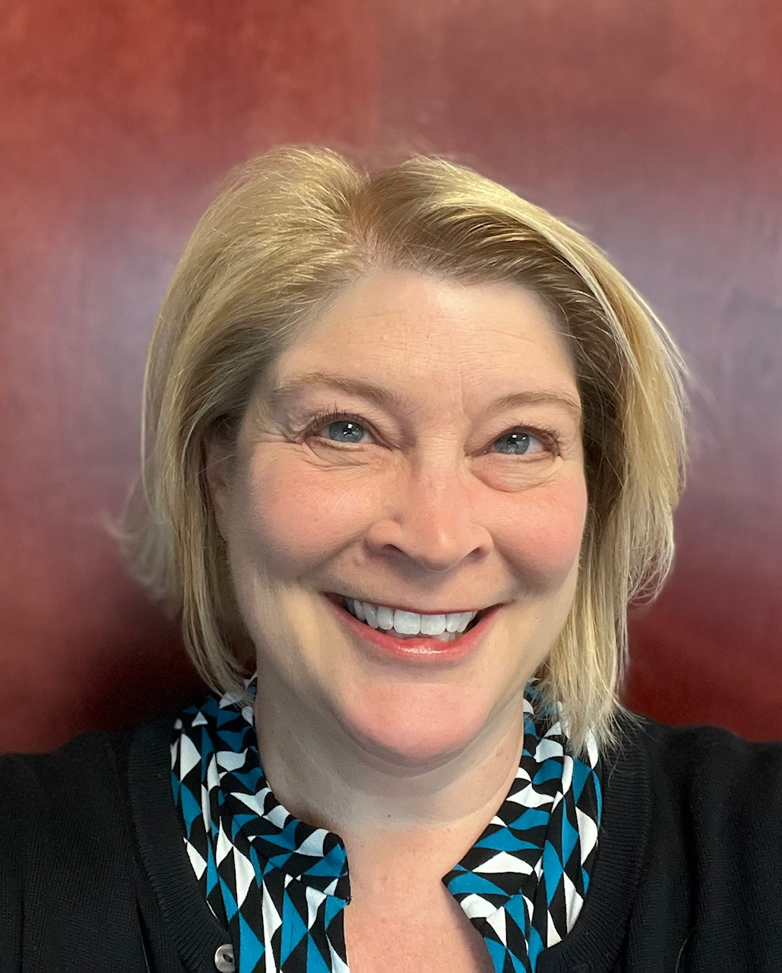
APR Ready to Roll
“Since establishing the Las Vegas APR Ready to Roll program in Spring 2020, 11 Las Vegas and Southern Utah PR pros have earned this designation and another four are currently studying for it. The format features a dedicated calendar with information sessions, portfolio reviews, panel presentation dates and study sessions led by other APRs. In addition to enhancing your PR knowledge, it’s also a great networking opportunity with other professionals who conduct the study sessions and provide expertise and encouragement along your APR journey.
If you have the opportunity, take advantage of it!”
Gretchen Papez, APR
Director of PR & Media, The Valley Health System, Las Vegas
Chair, Accreditation, APR Ready to Roll, PRSA Las Vegas Valley

Slide 19
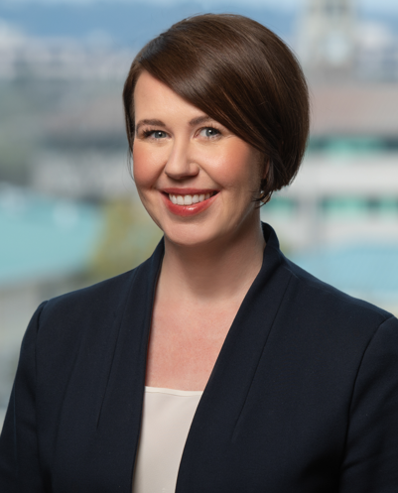
APR Ready to Roll
“The Arkansas PRSA Chapter's Ready to Roll program provides an accelerated and structured accreditation path that has helped over half of our current members succeed. As a newly accredited member and current chair, I attribute my success to the access and mentorship I received through Ready to Roll.”
Sandra McGrew, APR
Executive Director, Arkansas Center for Health Improvement (ACHI)
Chair, Accreditation, APR Ready to Roll, PRSA Arkansas

Slide 20

APR
The Accreditation in Public Relations (APR) integrates timeless communications principles with contemporary strategies and tactics.
Earning the credential
demonstrates competency,
proficiency, expertise, and a
commitment to lifelong
learning & ethical standards.

Slide 21
APR Ready To Roll
Program Background
What drives the increasing demand for APR pros?
Members of Universal Accreditation Board (UAB) organizations want an increased focus on Accreditation
Employers are demanding more strategic, sophisticated communication counsel from their PR staff
Traditional PR roles increasingly are being usurped by other consultants; practitioners want a meaningful distinction
There is a growing reliance on professional certification as a hiring and promotion criteria in a range of industries and occupations in the U.S. (become best friends with your SHRM-accredited recruiters in your organization)

Slide 22
APR Ready To Roll
Program Background
Why earn the APR?
APR is the strongest brand: UAB and APR represent more than 90% of all practitioners Accredited by any certification process in our field
Increasingly, there is a market distinction for APR holders
Most people do it for personal reasons
Larger numbers of people holding the APR will create a critical mass, stronger market awareness and increasing demand

Slide 23

Commitment
Follow These Steps. Did I mention Follow These Steps?
Apply – Complete Exam for APR
Application (1 year from notification to
advance to Panel Presentation and sit for
the APR exam)
Study – Complete & submit Panel
Presentation Questionnaire / 3 copies (HOT)
– to APR Chair 15 days before Panel Presentation (TBD)
  Read the APR Study Guide before completing
  Identify (1) PR campaign portfolio for Panel Presentation (samples & discussion during next week’s study session)
  Focus on your writing – exceptional

Slide 24
Commitment
Panel Presentation – Be prepared to discuss your career and the questionnaire
  Walk the panel through your portfolio (failure, growth)
  Demonstrate your knowledge of best practices in PR,
  Research, Planning, Implementation & Evaluation (RPIE)
APR Jump Start Info Session – Date, location
Attend – Plan to attend all Study Sessions (span of sessions dates)
Ask questions, learn from APR leaders, their APR journey
Schedule APR Computer-based Exam (Date)
Sit for Computer-based Exam / virtual (Date)
APR Pinning Ceremony – ??? (INSERT)
Demonstrate lifelong learning through maintenance (submit form every 3 years / 10 credits required)

Slide 25
Resources
APR Study Guide (verrrry helpful!)
Cutlip and Center’s Effective Public Relations
  Don’t invest $100 – Used or Lending Library
Take the sample exam (did you take it yet?)
www.praccreditation.org/resources/candidates
Talk to APRs -- ask for a mentor, have them review your work – take their gift of feedback!

Slide 26
Support and Expectations
We are here for YOU.
APR mentor? See Juanita!
Someone helped us… we will help YOU.
YOU will become an advocate for APR – other PR practitioners, your employer, media.
Job Descriptions – APR preferred/required
Support your Chapter – board / committee service, consider APR committee / chair

Slide 27
Portfolio Review /
Panel Presentation
Panel Presentations
  First step in the two-part Examination process
  Includes a portfolio review and an advance Questionnaire
  Assesses KSAs that are not able to be evaluated on the computer-based Examination
  Conducted by a 3-member panel of Accredited professionals
  Dress: Business professional (job interview)

Slide 28
Portfolio Review /
Panel Presentation
So what happens next?
  Recommendation to the UAB to Advance or Not Advance the candidate to take the computer-based Examination
  Candidates may take the computer-based Examination only after they have been Advanced from the Panel Presentation

Slide 29
Portfolio Review /
Panel Presentation
THIS JUST IN:
Panel Presentation Dates (# Groups)
Date / Time
Location
Date / Time
Location

Slide 30
Demystifying the
APR Exam
The Computer-based Exam (CBE) is computer-delivered and scored (requires 2 forms of I.D.)
Exam is 100% multiple-choice questions
Virtual Exam takes 3 hours, 45 minutes
Results are immediate (including percentage scores in each section)

Slide 31
Demystifying the
APR Exam
Who is eligible?
  Members of all 8 participating organizations (POs)
  Recommended 5+ years of paid, full-time professional experience, or in teaching or administration of public relations courses in an accredited college or university
Fee: $385
  Some POs offer stipends to their members
Good “for life,” with fulfillment of maintenance of Accreditation requirements and continued membership in participating organization

Slide 32
Demystifying the
APR Exam
The Examination process tests 43 specific KSAs in 6 areas
of professional practice; 12 are tested in the Panel Presentation, 31 in the computer-based Examination:
(33%) Researching, Planning, Implementing and Evaluating Programs
(13%) Applying Ethics and Law
(13%) Managing Issues and Crisis Communication
(8%) Understanding Communication Models, Theories and History of the Profession
(18%) Leading the Public Relations Function
(15%) Managing Relationships

Slide 33

Recap & Questions
You’re Ready to Lead Your
APR Ready to Roll Program!
All Program Resources at Your Fingertips
Understand the APR
Program Background
Commitment
Resources
Support & Expectations
Portfolio Review & Panel
Presentation
Demystifying the APR Exam

Slide 34
JUMP START:
Testing the Waters, Pursuing Your APR

